Slide 1
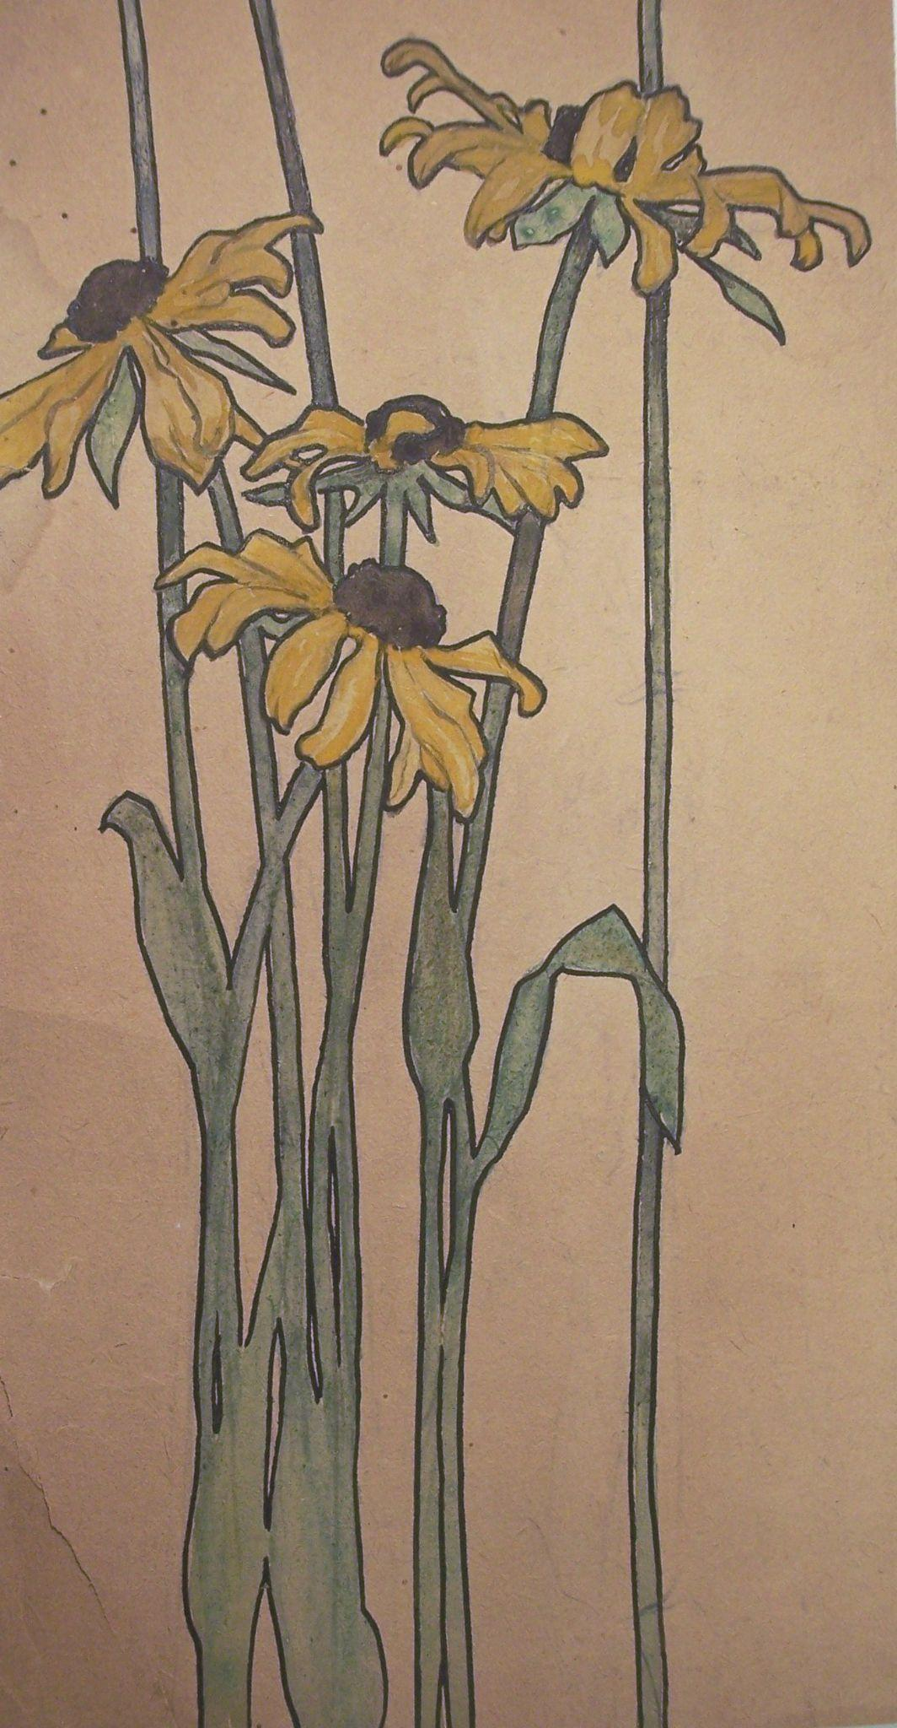
Permanent Collection Lesson Plan
Visual Art and Environmental Science
with Harriet Joor’s Black-Eyed Susan
By Meghan Kreeger
VIAR 415: Advanced Methodology in Art Education
Professor: Dr. Claire Schultz
Fall 2020, University of Louisiana at Lafayette

Slide 2
Mixed Media Flowers
Brief Lesson Description/Overview:
Students will pick flowers or find an image of a flower they like the most. Students will learn about the flower they have chosen and take notes in their sketchbooks. In addition, students will learn more about cropping and composition while completing this assignment. Once they have the flower picked out and have notes/sketches completed, they will draw their flower and practice cropping before using mixed media on the paper to complete the piece.
Grade Level (Range): Middle School (6th, 7th, & 8th)
Integration Content Area(s): Science → Environmental Science

Slide 3
Objectives
Students will be able to identify the flower they picked and accurately draw it on paper.
Students will be able to identify the flower they have chosen and give an explanation on why they have chosen that particular flower.
Students will be able to distort the picture plane by utilizing cropping in their composition.
Students will be able to effectively demonstrate their abilities to use mixed media in their composition.

Slide 4
Big Ideas/Essentials Questions
When is creative art ready to share?
How does collaboration expand the creative process?
How do life experiences influence the way you relate to art?
How does nature play a role in art?
How does cropping and composition impact the way a piece is read?

Slide 5
National Art Standards Domain(s)
VA: Cr2.2.6a
Explain environmental implications of conservation, care, and clean-up of art materials, tools, and equipment.
VA: Pr5.1.7a
Based on criteria, analyze and evaluate methods of preparing and presenting art.
VA: Re.7.2.6a
Analyze ways that visual components and cultural associations suggest by images influence ideas, emotions, and actions.
VA:Cn11.1.6a
Analyze how art reflects changing times, traditions, resources, and cultural uses.

Slide 6
Harriet Joor (American, 1875-1965)
Black-Eyed Susan, 1898-1901
Graphite and watercolor on paper
H-11 W-6 inches
Harriet Joor Collection of Botanical Sketches
Gift of Eleanor Mitchell Yount and Thomas M. Mitchell. In memory of Eleanor Morgan Mitchell.
2008.05.49

Slide 7
Historical Context/Connections
Harriet Joor taught at UL from 1923 to 1940. She was known for her watercolor paintings, pottery, and embroidery. She was among the first to enroll in the Arts school at Newcomb College. Her father was a botany professor at Tulane University which may have to do with her interest in flowers in her subject matter.

Slide 8
Studio Connections
Media: Mixed Media on Paper
Elements: Color, Line, Shape, Texture
Principles: Harmony, Contrast, Movement
Vocabulary: Botany, Mixed Media, Blind Contour, Contour

Slide 9
Instructional Steps/Information
Opening Hook:
Can anyone tell me what their favorite flower is? Who enjoys going to pick flowers? Well this week you are in luck because our project will allow us to go into nature and view/pick flowers! In addition, we will learn about an artist by the name of Harriet Joor who has a background dealing with flowers. Also, we will be connecting our lesson to go along with things learned in an environmental science class, flowers and botany!
Demonstration:
Students will see examples of how the various materials will look like on mixed media paper.
Student Work:
Students work will be critiqued throughout the course of the project duration in order to make sure everyone is on track and to hear feedback from their peers. In addition, when the projects are complete students will participate in a class wide critique before submitting the final piece.
Final Outcome:
The outcome is for students to learn more about artist Harriet Joor while learning about her background with flowers and botany. In addition, to learn that there is multiple outcomes to a piece when completed with mixed media.

Slide 10
Class Plan
Day 1:
Introduce the lesson for the week to the students. Explain what the project will be comprised of and what is expected of them. Students will start researching and looking for their favorite type of flower and what materials to utilize. Also, students may incorporate leaves or sticks into their composition. Students will be able to use a viewfinder to distort and crop their image field. In addition, fake or silk flowers will be available to use in case someone cannot find a flower they like or if they do not want to harm nature.
Day 2:
Students will present their research and what flower they have chosen for this project. Each student will present a powerpoint presentation on their research and explain their reasoning for choosing that particular flower. Once presentations are done students will beginning sketching their ideas and prepare to complete their projects. In addition, students will practice distorting their composition by completing observational drawings. Students will be asked to have their 3 different types of mediums picked to create their projects.

Slide 11
Day 3:
Students will spend the class period practicing in their sketchbooks using the media they have selected for the project. In addition, students will utilize a viewfinder to see how to distort/crop a composition. Students will practice spilling the visual information off the page to create visual interest and implied imagery. Once students have completed their sketches/practices they may begin their projects!
Day 4:
Students will continue to work on their projects until about the halfway point through the class. At the halfway point, all the students will participate in a mini critique to see how their peers are doing so far with the project and provide feedback. Once the critique is over, students will go back to completing their projects.

Slide 12
Day 5:
Students will come into class and immediately continue working on their projects and continue to do so until they finish or reach the end of the class period. Students who finish early may choose a sketch to complete in their sketchbook while others are still completing their projects.
Day 6:
During the final day of the project, students will participate in another critique and view each other's work while giving feedback to their peers. Students will explain why they chose the flower and mediums they did. In addition, their thoughts and feelings they had while completing this project. Students will volunteer one by one to present their projects. Students will also have to be vocal throughout the whole critique in order to receive full credit.

Slide 13
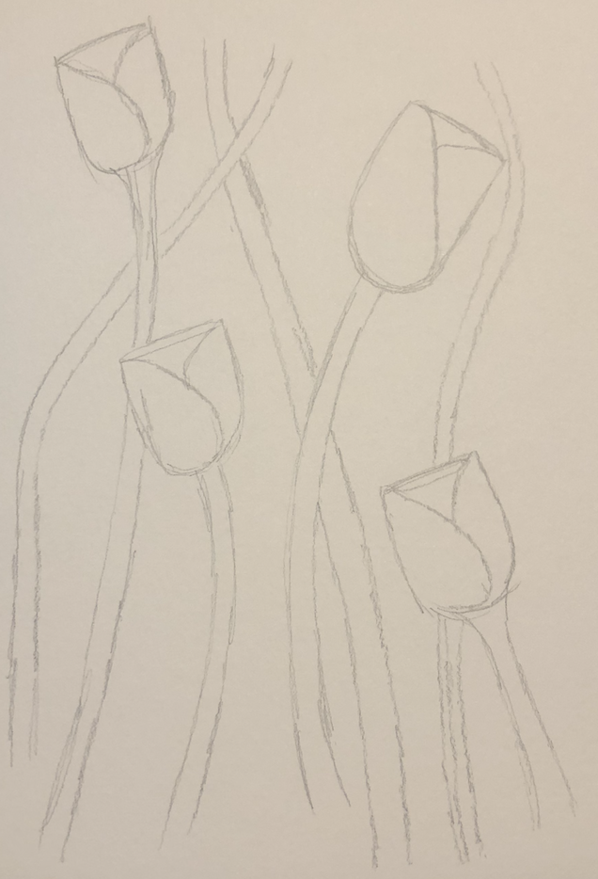
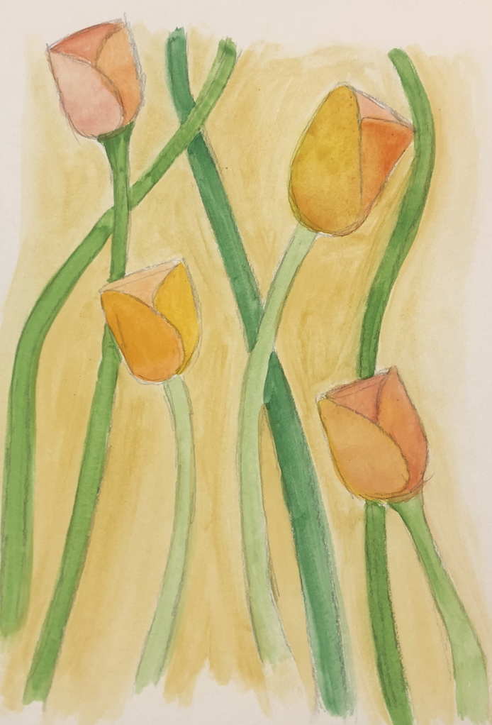
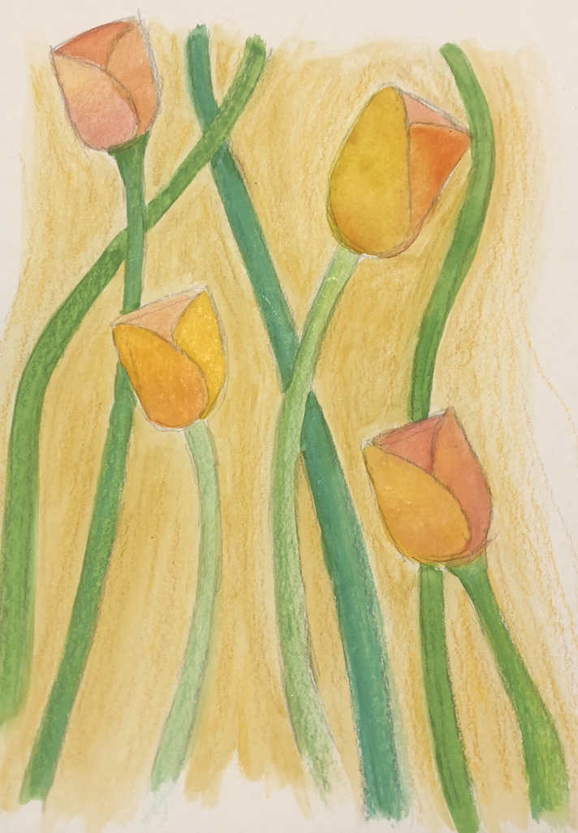
Expected Progress

Slide 14
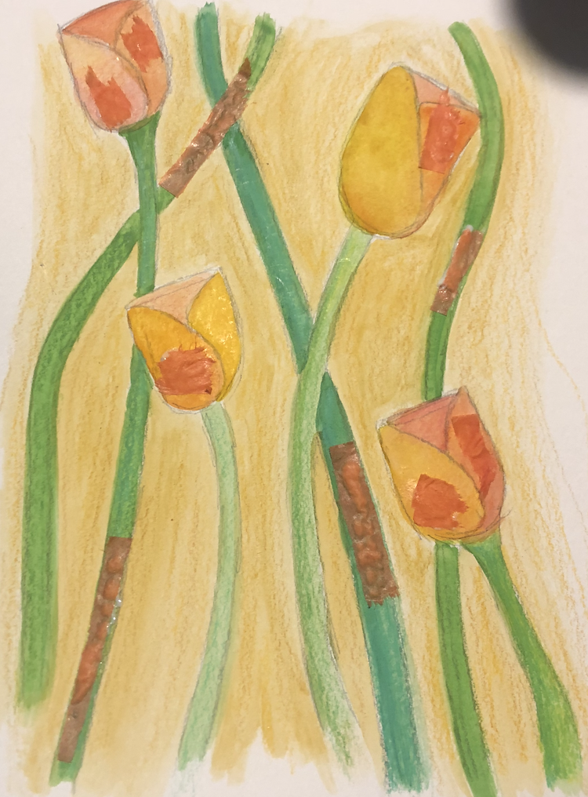
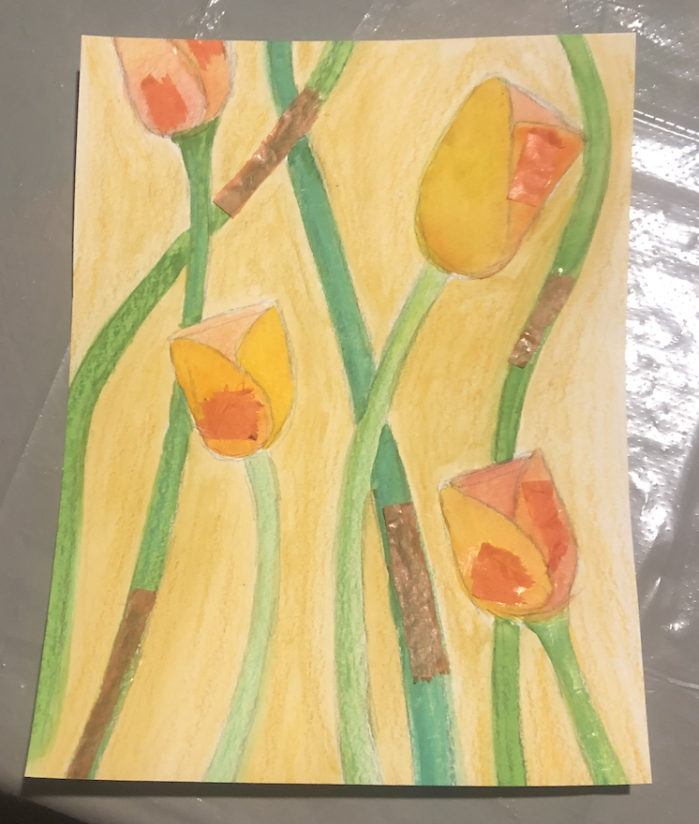
Continued...

Slide 15
Final Product

