Slide 1
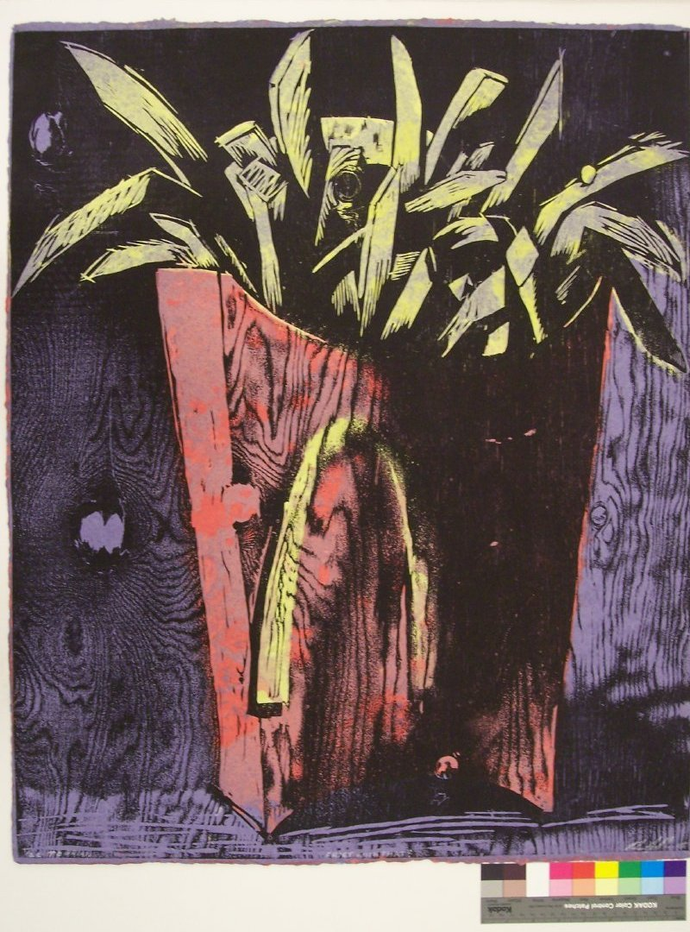
Permanent Collection Lesson Plan
Visual Art and English Language Arts
with Ross Jahnke’s Fries With That?
By Gabrielle Koch
VIAR 216: Art in Education, Fall 2020
Professor: Dr. Claire Schultz
University of Louisiana at Lafayette

Slide 2
Brief Lesson Description
Food is a motivating factor in most people’s lives. At some level, everyone can connect with different types of food in a positive way. Young children have had enough experience with food to do a project about their favorite food. After the completion of their work of art, students will be asked to compose a free verse poem based on how their senses perceive the food item they created in their art piece.

Slide 3
Grade Level (Range):
3rd grade
Integrated Content Area(s):
Visual Arts and ELA
Objectives:
ELA: The learner will develop a free verse poem that is inspired by their torn paper collage.
Visual Arts: The learner will be able to create a representation of a food item using a torn paper mosaic collage of different textured or layered papers.

Slide 4
Big Ideas:
Visual Art themes: Shape/Form, Unity, Realism, Still life, Collage
Social/Cultural Themes: Traditions, Rituals, Tastes
Essential Questions:
How do we use our senses to explore, investigate and experience the world of food around us?
What is your favorite food / snack?
What does it look like?
What does it sound like?
What does it smell like?
What does it taste like?
What does it feel like?

Slide 5
National Standards Domain(s): Create
3rd grade VA:Cr2.3.3a
Individually or collaboratively construct representations, diagrams, or maps of places that are part of everyday life.
3rd grade Writing Standard
Text Types and Purposes
1. Write opinion pieces on topic supporting a point of view with reasons

Slide 6
Ross Jahnke
Fries With That?, 2005
Edition 1/22
Woodcut on hand-made paper
H-32.125 W-26.375 inches
Marais Press Print Collection
Gift of Brian Kelly
2010.08.53

Slide 7
Historical Context/Connections
Ross Jahnke is a professor and art interim department head at Nicholls State University. He is both a printmaker and a painter whose work has been exhibited throughout the United States. Jahnke is a recipient of the Louisiana Division of Art Fellowship and has received numerous grants for visual art projects.
Jahnke used the technique of woodcut printmaking on handmade paper for this piece of artwork. He hand-made the paper, drew an image on a block of wood, then carved out the negative spaces. Incidentally, what is left is a stamp of the image. He then rolled ink with a roller over the woodcut. He then applied pressure and transferred the image onto the paper. To add more depth, he had to carve out multiple stamps to layer it on the hand-made piece of paper.
Allowing the students to create an original work of art using paper was something that I thought they would enjoy.

Slide 8
Studio Connections
The media of torn paper being layered will allow the students to work on kinesthetic fine motor skills. The technique will allow students that are not comfortable with painting or drawing to create an artistic work that is personal and relevant to their lives. Being given the freedom to write a free verse poem about their artistic food creation will allow students to have ownership of the entire project.

Slide 9
Materials List
Scrap construction paper / whole construction paper
Cardstock or poster board
Glue stick
Tissue paper
Your “thinking cap” and a hungry belly

Slide 10
Day 1:
Opening hook: Have a collage of images on the board that represent different types of food/meals. Teacher points out his/her favorite and tells describes the food using the five senses to do so.
Children are allowed to share their favorite type of food/meal and are encouraged to tell why using their five senses.
Teacher will then explain the art activity while showing his/her sample work to the class, along with pictures that demonstrate the process that was used.

Slide 11
Day 1:
1. Allow students to choose the food item they want to create. Encourage them to think of their favorite restaurant, fast food, or home-cooked item.
2. Students then choose the color paper they want as a background.
3. Students then choose the different color paper they want to use to create their food item.
4. Students tear the color paper slowly into various shapes and begin to design their food item. Teacher will have magazines and printed pictures with different food items displayed for the students to use as a design guide.
5. Glue pieces into place carefully on the background paper.

Slide 12
Day 2:
Opening Hook: Teacher will play the song “Cheeseburger in Paradise” as students enter the room. He/she will review the picture that was done as a torn paper collage, in this case the Double Cheeseburger.
Teacher will share the original free-verse poem written about the Double Cheeseburger. Students will began composing their own.
The format of the free verse poem will be as follows:
1st line - How does your food look?
2nd line- How does your food sound?
3rd line - How does your food smell?
4th line - How does your food taste?
5th line - How does your food feel?
**Note if the children are not finished their art work let them complete it.

Slide 13
Day 3:
Students will do an oral presentation of their artwork and original free-verse poem to the class.
Artwork will be displayed in the class art gallery.

Slide 14
Definitions
Shape - the form or conditional appearance of an object
Unity - Combining composite parts to make a whole
Tactile - touchable or sensed by touch

Slide 15
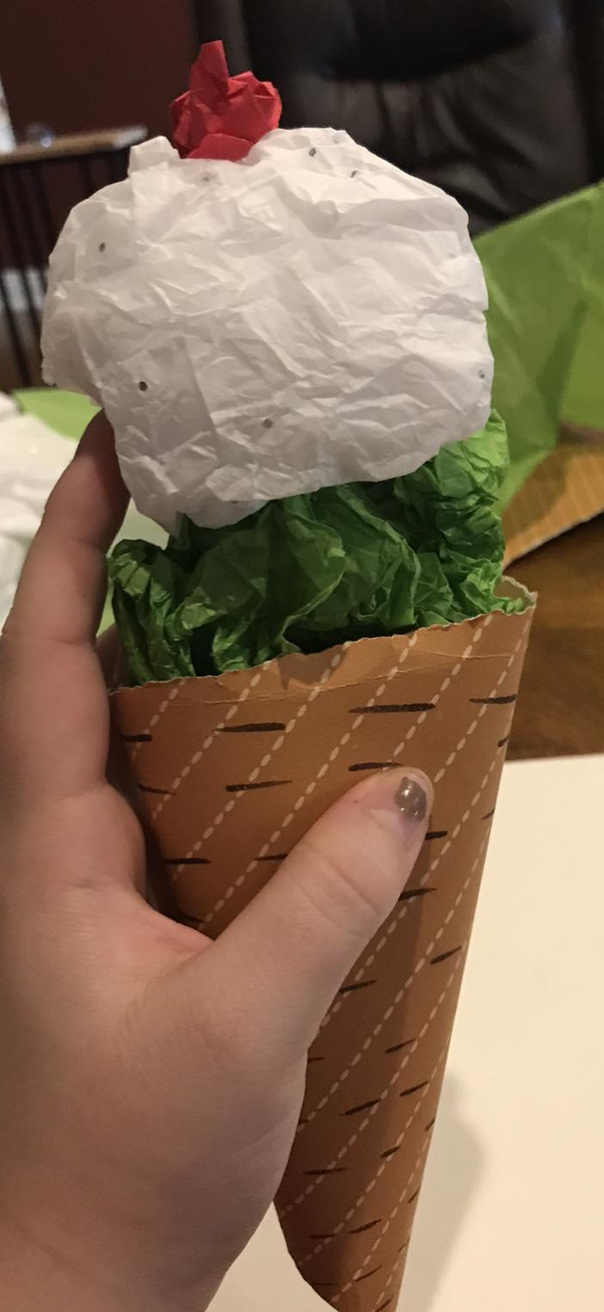
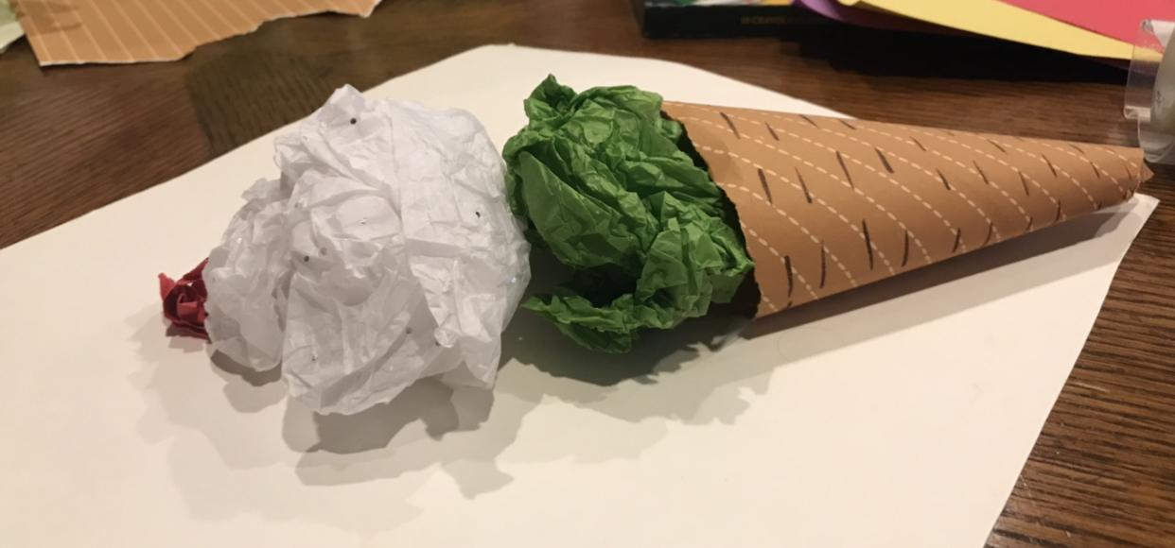
Extra Ideas
You could have the student create a 3D model
You would have the children bring in old box, tubes, jars, ect. To create the model
Have a “class meal” and have the students in groups to create a 5 course meal model

Slide 16
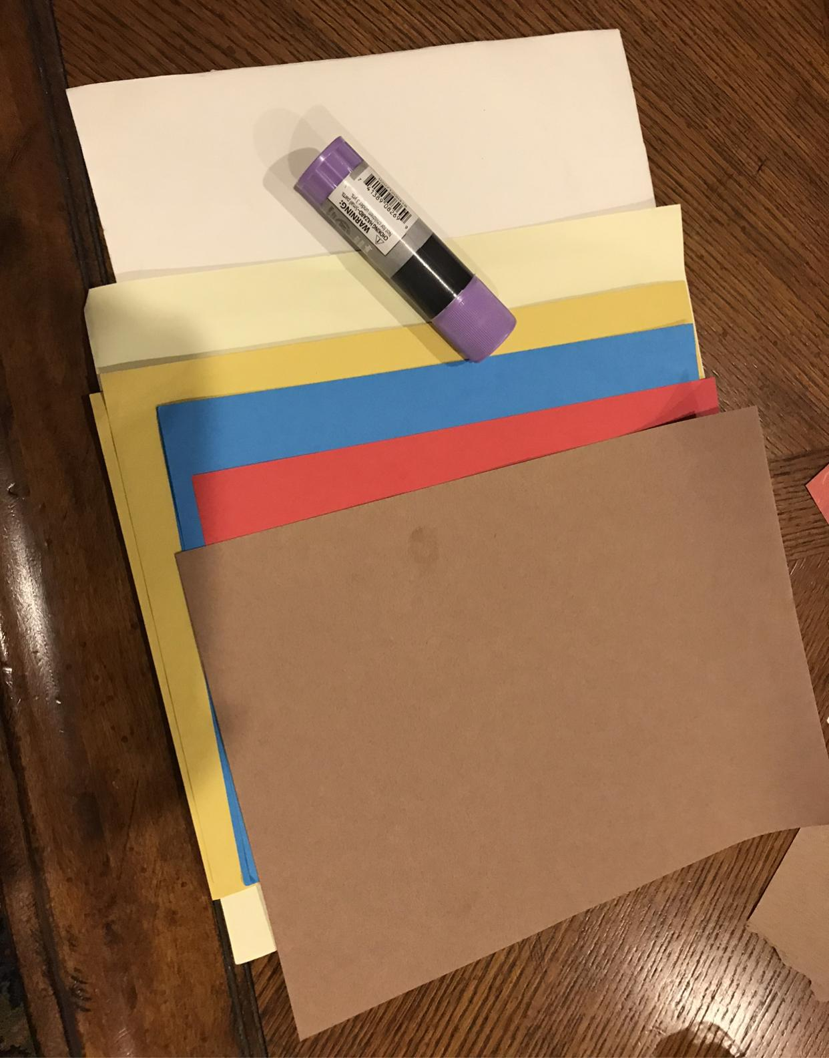
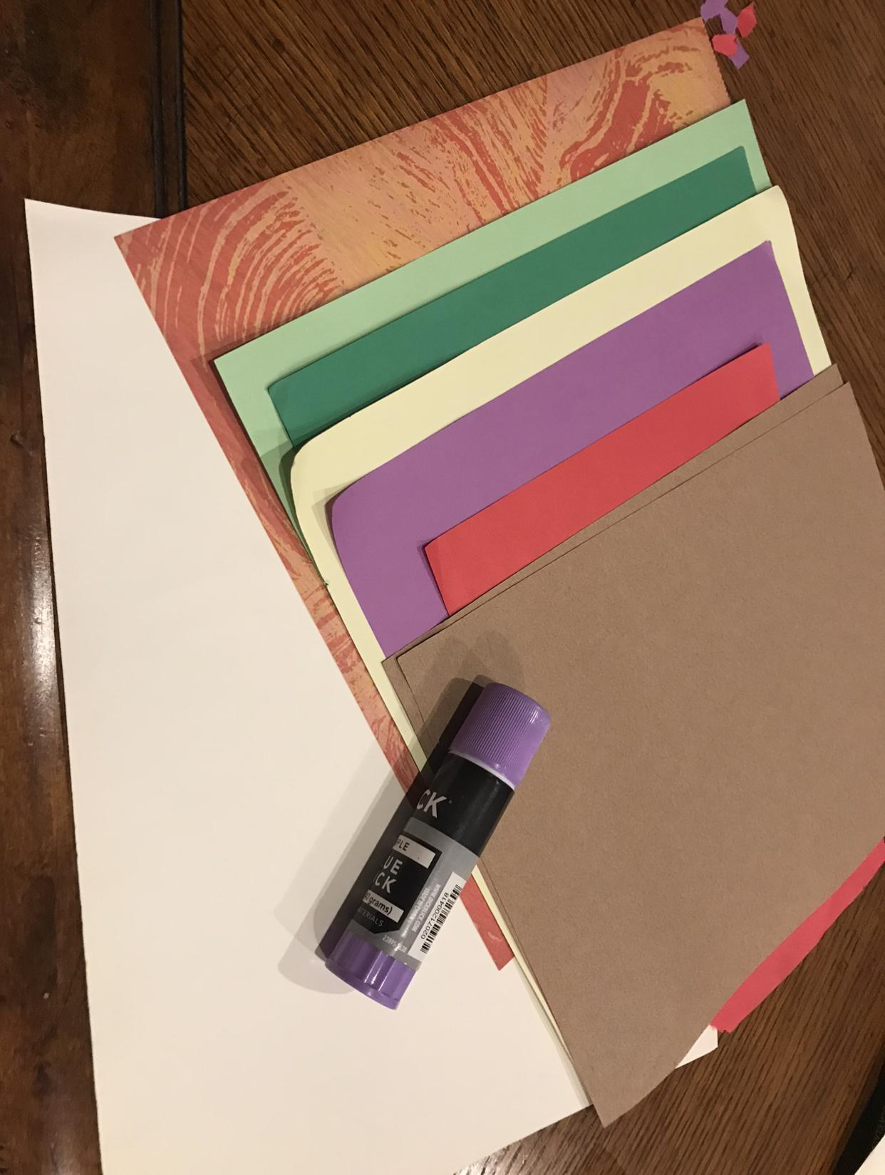
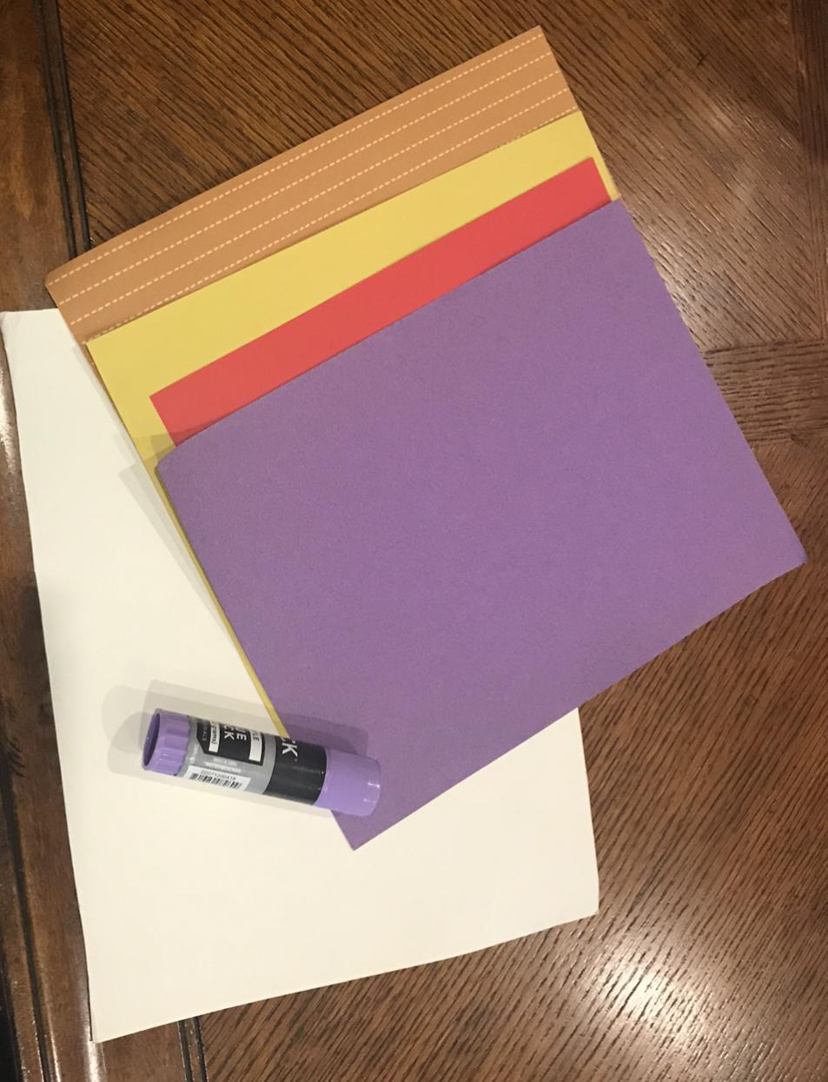
Step by Step Demonstration
Students then choose the color paper they want as a background. Students then choose the different color paper they want to use to create their picture.

Slide 17
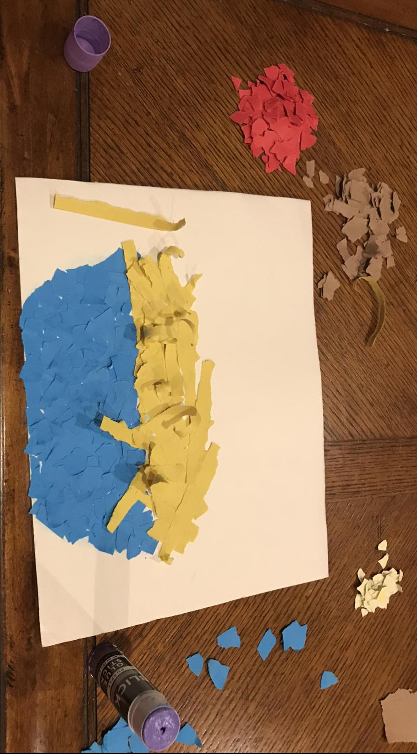
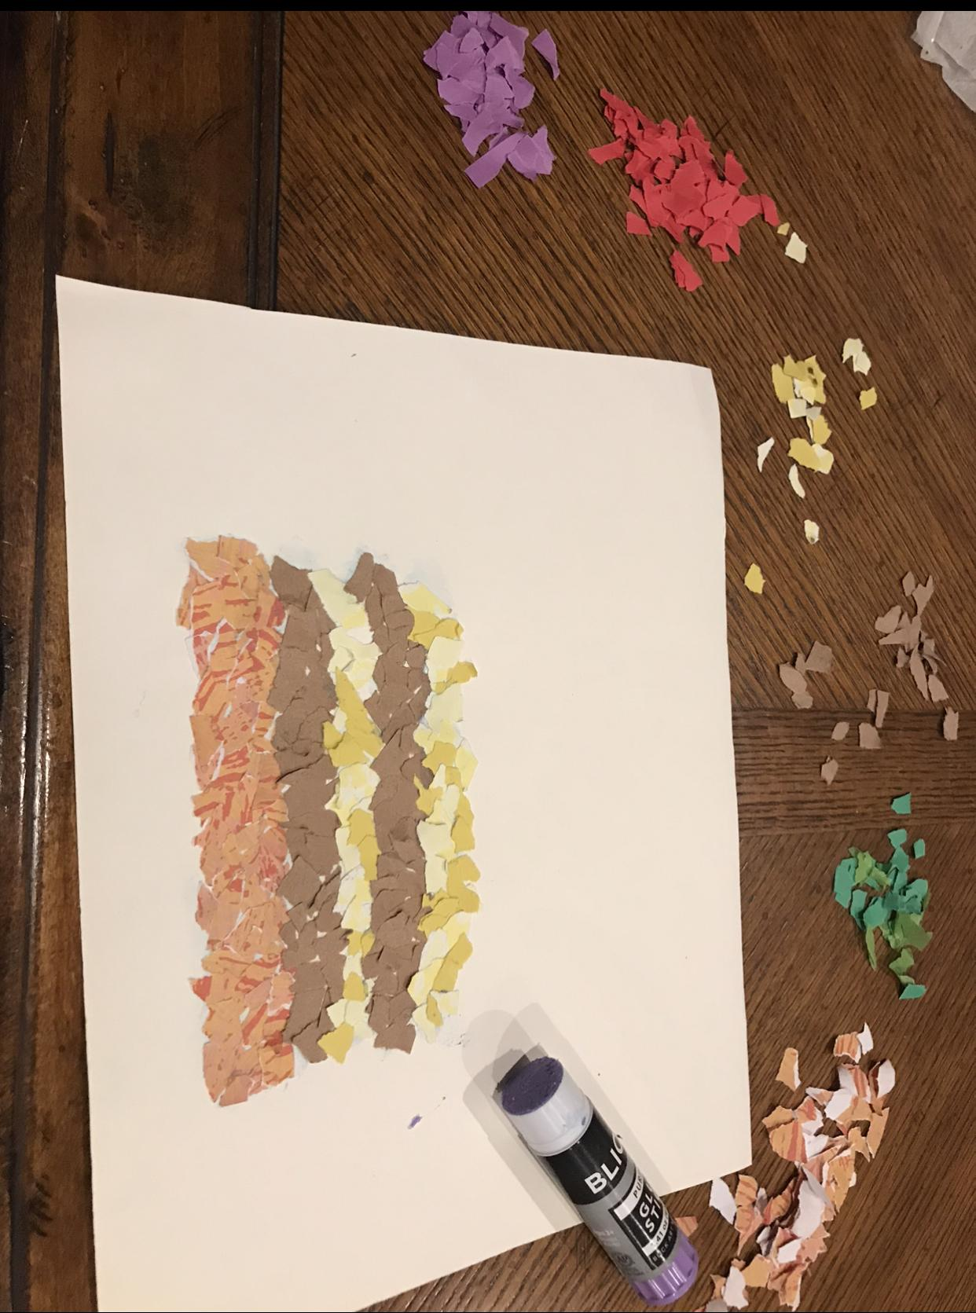
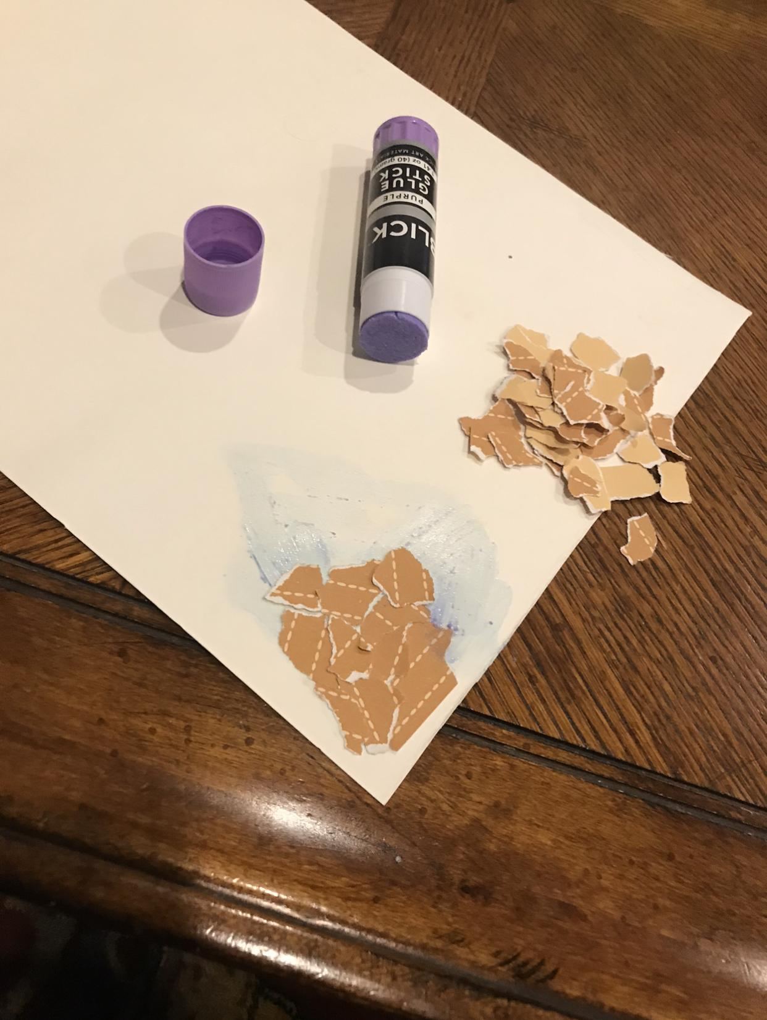
Step by Step Demonstration
Students tear the colored paper slowly into various shapes and begin to design their food item. Teacher will have magazine and printed pictures with different food items displayed for the students to use as a design guide. Glue pieces into place carefully on the background paper.

Slide 18
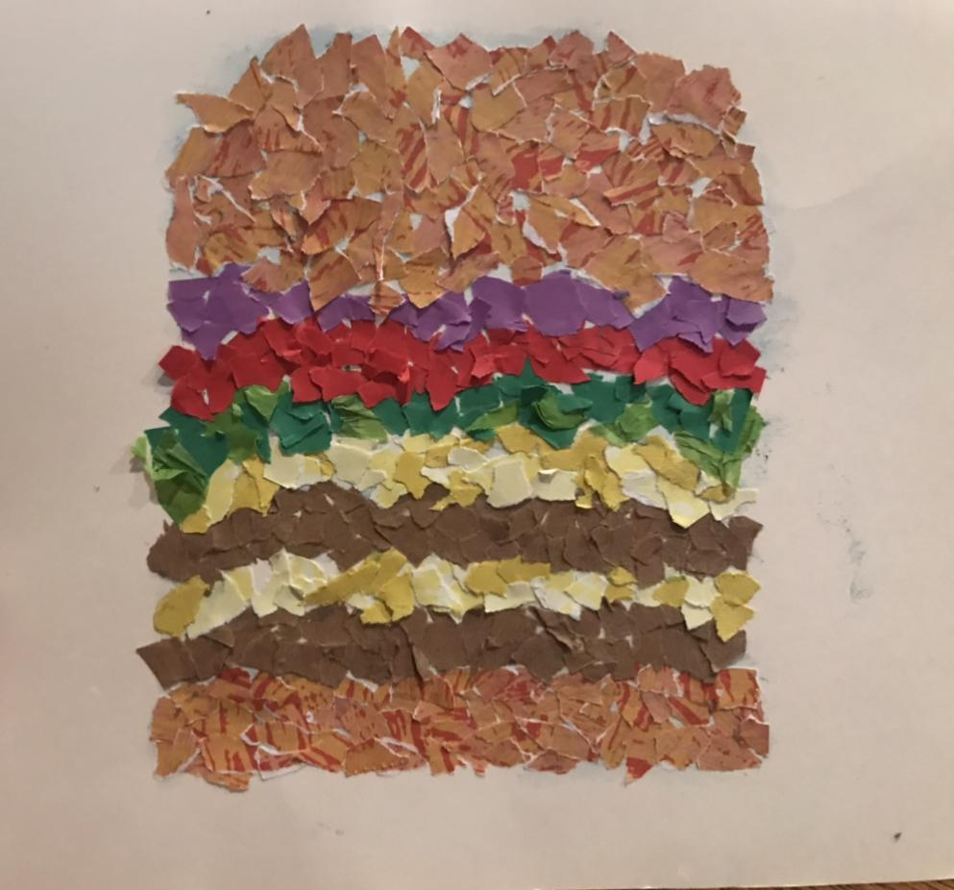
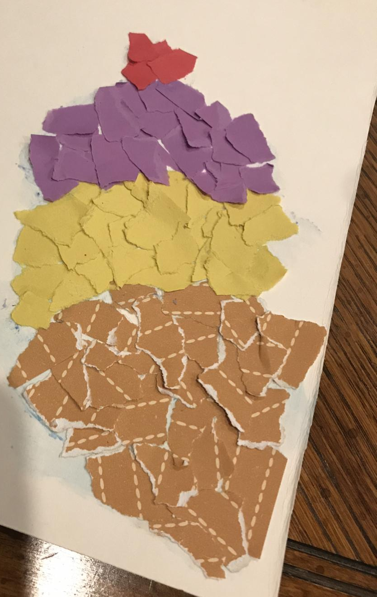
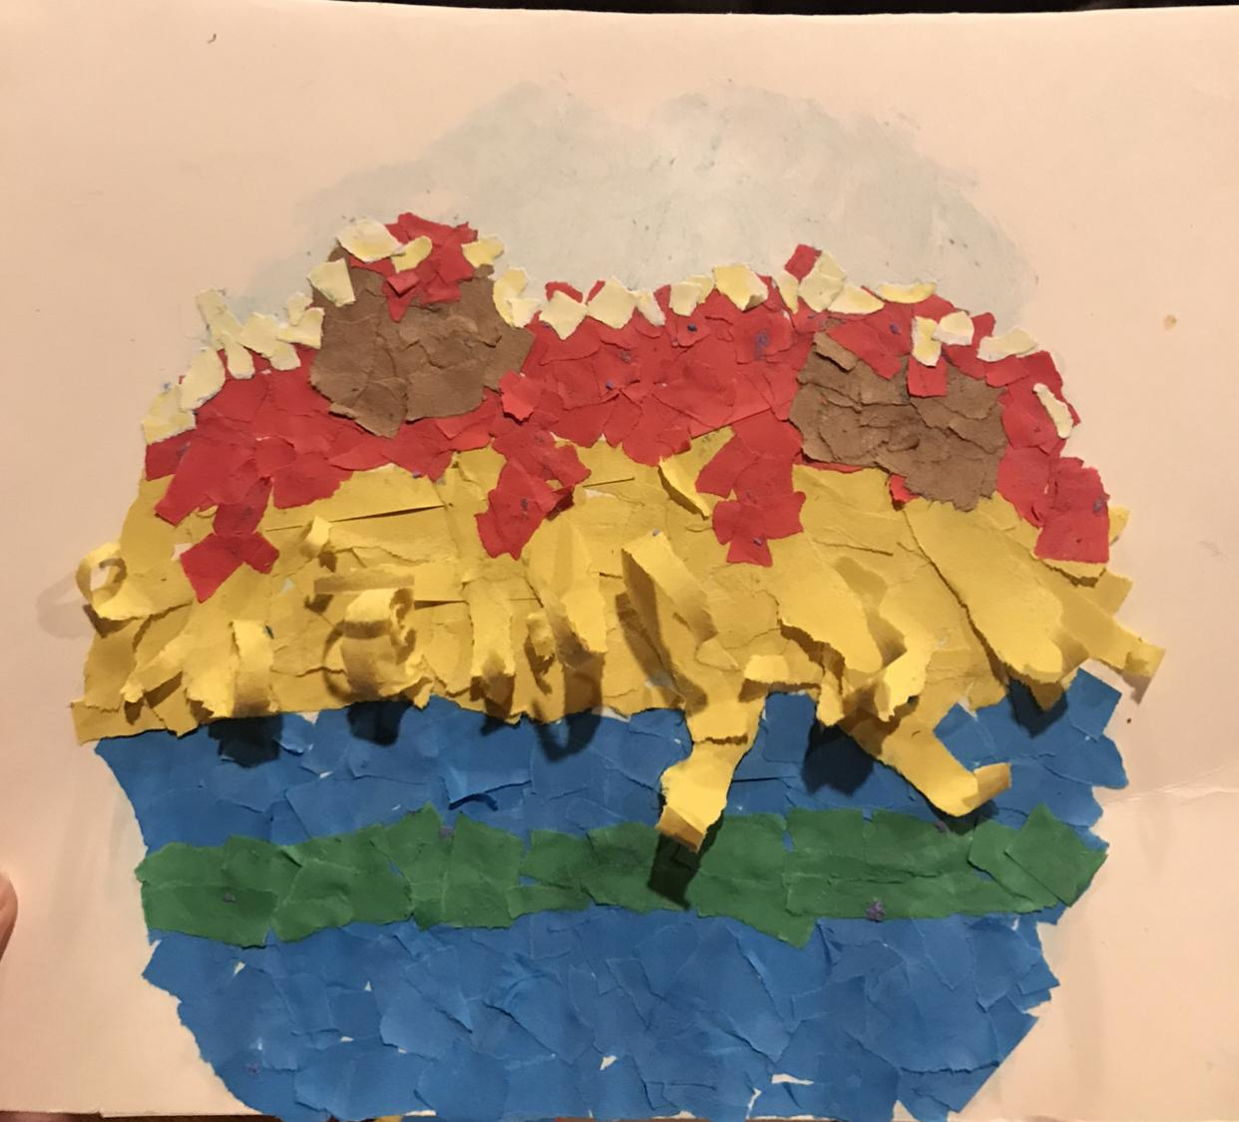
Step by Step Demonstration
The completed product is then cut out and mounted on a separate piece of posterboard or cardstock to make it sturdy. At this point, the student is encouraged to begin working on their original free-verse poem following the format provided by the teacher.
**Note: If you tear paper quickly and narrowly, you will enable the paper to curl.. Remember, no scissors!

Slide 19
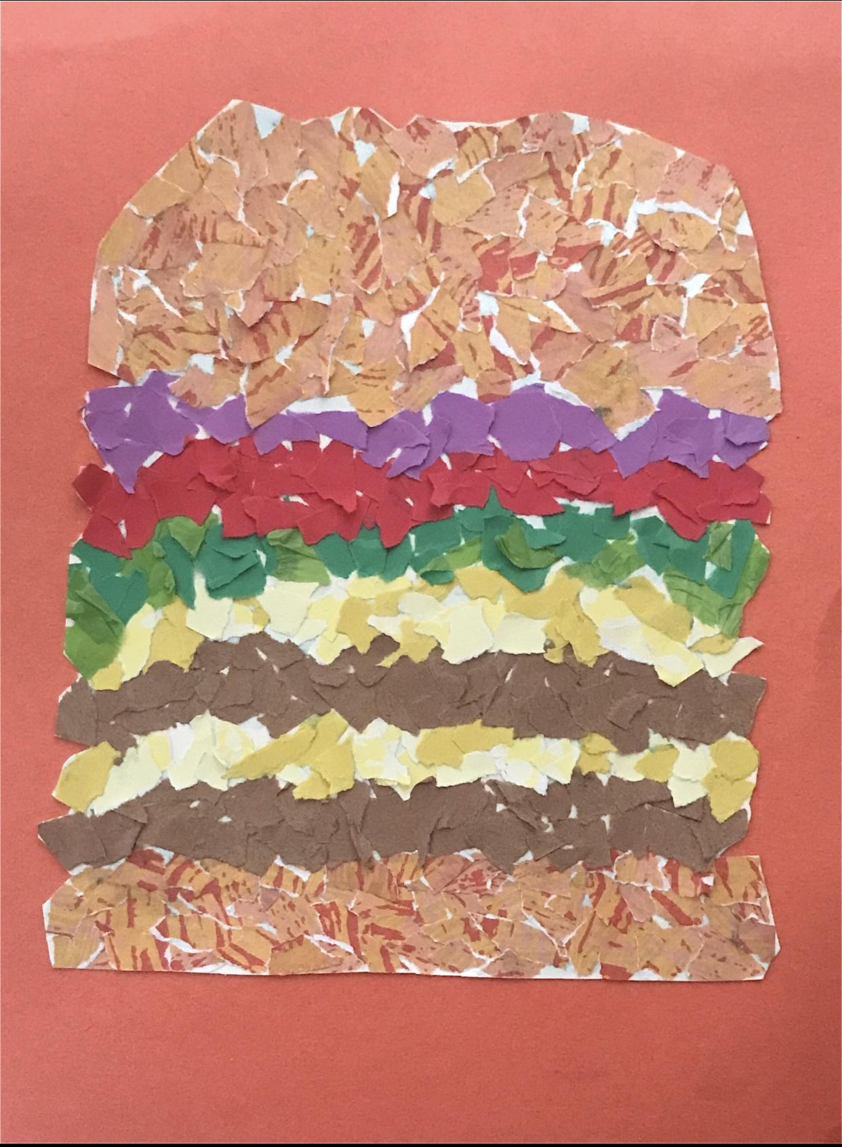
Final Product
Double Cheese Burger
I see two juicy patty in between layers of melted cheese
It sounds like sizzling of the patties cooking and the crunch of the lettuce from a big bite
Its my burger and it smells as a burger should
It tastes like good times around the dinner table
It feels like all the flavors coming down to satisfy my hunger

Slide 20
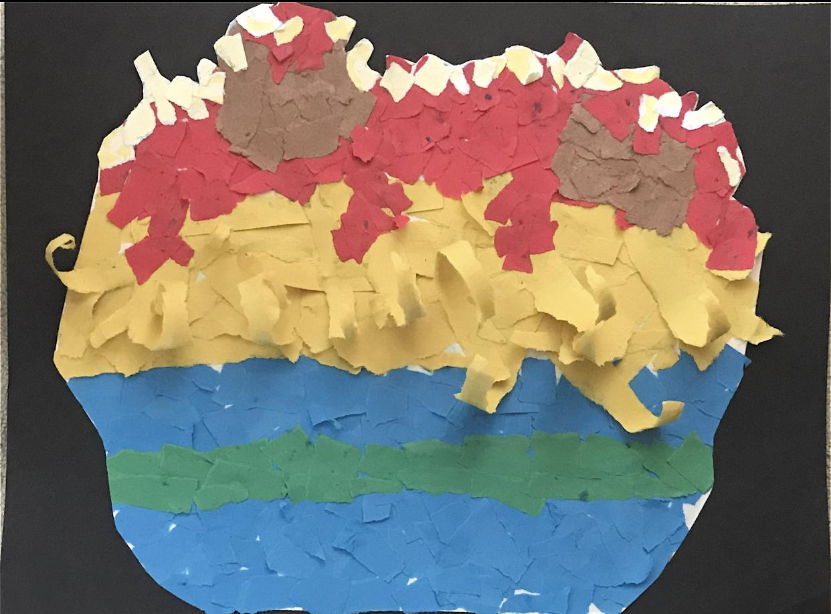
Final Product
Spaghetti and “Mmmeatballs”
It looks like steam fogging up my glasses when pulling the meatballs out of the oven
It sounds like the pops of the sauce hitting the top of the pot
It smells like the herbs and spices growing in my backyard
Its one of the only tastes that truly satisfies my soul
It feels like a journey along the back road of rural Italy

Slide 21
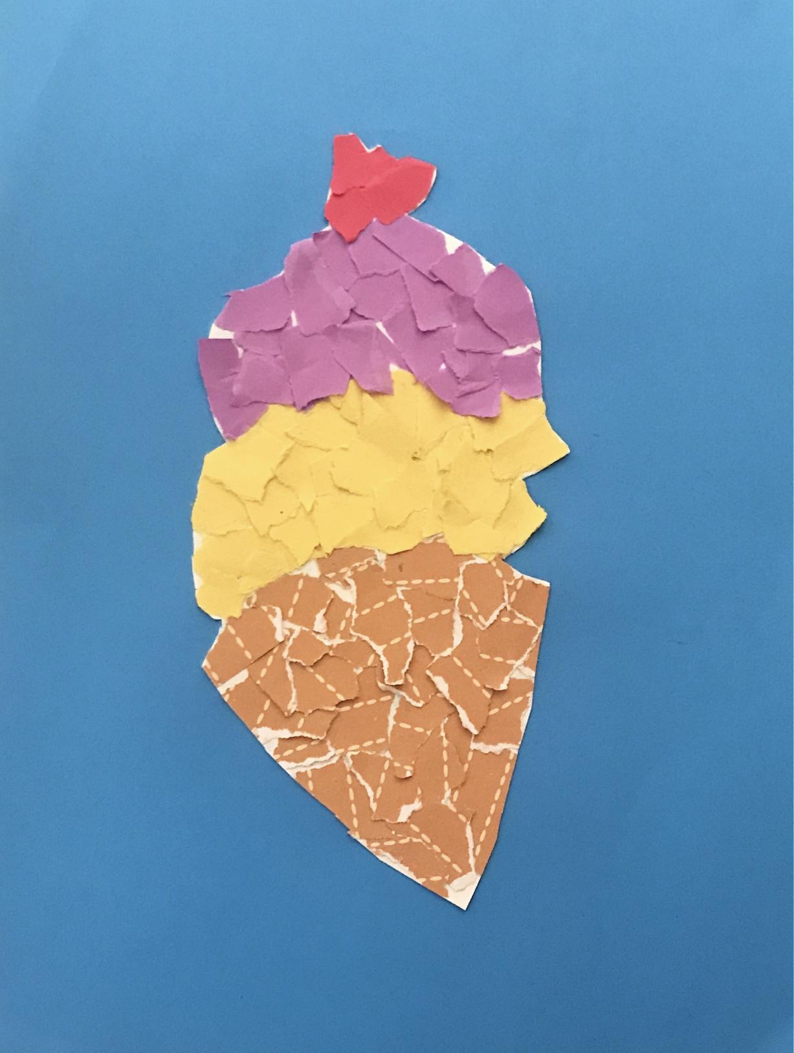
Final Product
Ice Scream Delight
It looks like the true frozen queen of my dreams
It sounds like the ice cream truck driving down the street
It smells like my 3rd birthday cake at the skate zone
It taste like just the right amount of sugar to have a symphony with my taste buds
It feels like the midnight snacks I’d enjoy with my grandpa

Slide 22
Rubric
Objectives | Exceeds | Meets | Does Not Meet
Student created a representation of a food item using a torn paper mosaic collage of different textured papers.
Student developed a free verse poem that is inspired by their torn paper collage

